Slide 1
LENDING CLUB CASE STUDY
GROUP FACILITATOR:- MRINAL S. RAUT
GROUP MEMBER:- KARTHIK V. PAI

Slide 2
Case Study Objectives
1.To identify a potential defaulter based on his/her history of transactions with Lending Club.
2.Perform an analysis to understand the driving factors(or driver variables) behind loan default, I.e. the variables which are strong indicators of default.
3.The Loan Lending Club may utilize this analysis for it’s portfolio and risk assessment of new loan applicants.

Slide 3
SUMMARY
1. Data Cleaning
2. Data Exploration/Data Transformation
3. Observations
4. Suggestions

Slide 4
Steps Performed in Data Cleaning
Check Duplicate Rows
Delete Rows: Delete unnecessary rows.
Missing Values: Analyse missing values with appropriate approach.
Drop columns: drop the columns from the data frame.
Remove Outliers: This will make it easier to visualize the plots.

Slide 5
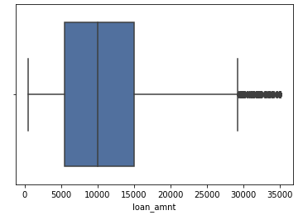
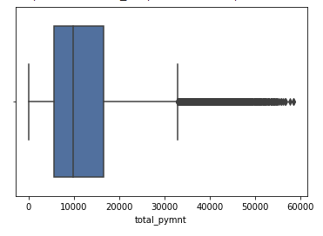
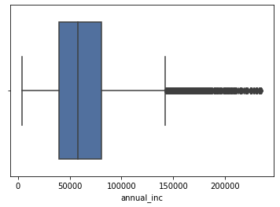
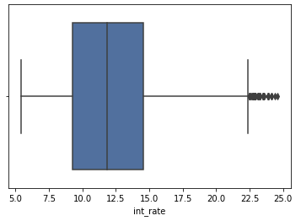
Data Exploration Analysis

Slide 6
Observations:-
82.96 percent loans were fully paid.
Close to 14% loans were charged off.
Most of the loans are taken for debt consolidation(47%) and Credit card bill payment
Other is also one of the main area where loans were taken.
Average interest rate is 12 %
After 75% percentile interest rate zoom'ed to 25% from 15%.

Slide 7
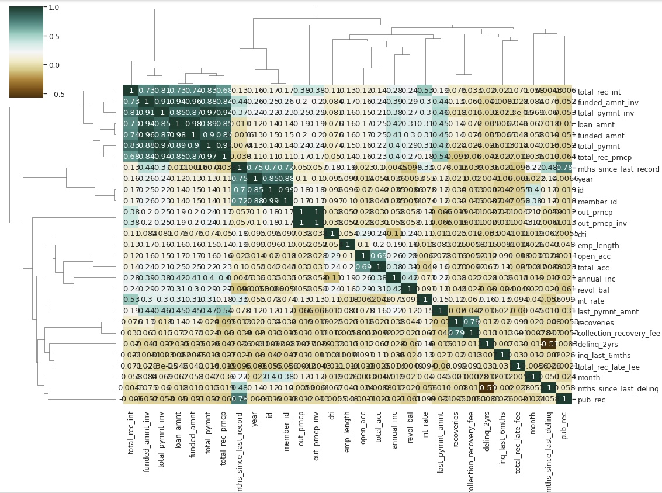
Correlation Matrix

Slide 8
Observation is that Loan amount, investor amount, funding amount are strongly correlated.
Annual income with DTI(Debt-to-income ratio) is negatively correalted.
Debt income ratio is the percentage of a consumer's monthly gross income that goes toward paying debts.
That means when annual income is low DTI is high & vice versa.
Positive correlation between annual income and employment years.
That means income increases with work experience.

Slide 9
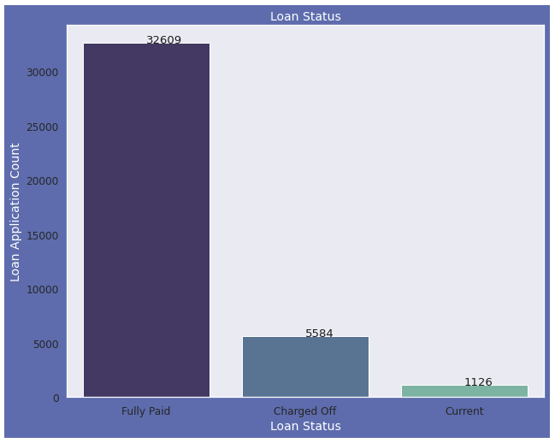
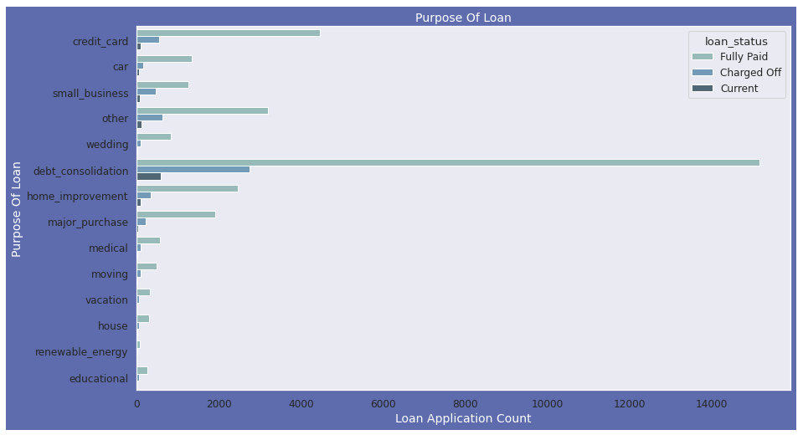
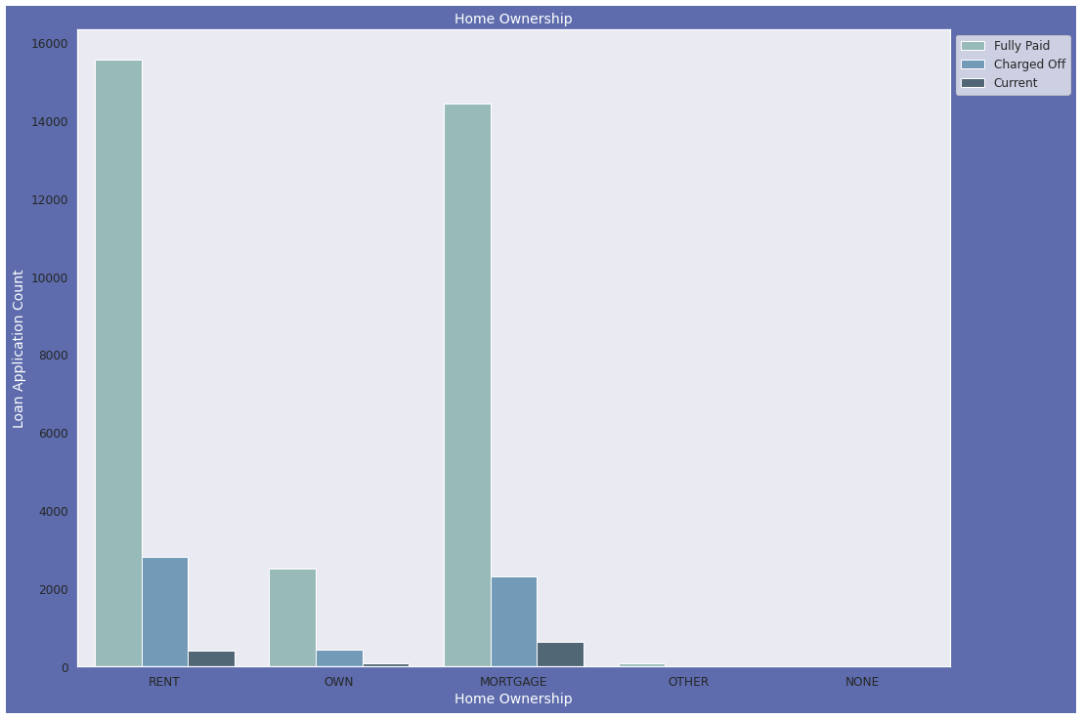
Loan Status, Application & Home Ownership Analysis

Slide 10
Observations :
Plot shows that close to 14% loans were charged off out of total loan issued.
Plot shows that most of the loans were taken for the purpose of debt consolidation & paying credit card bill.
Number of charged off count also high too for these loans.
Plot shows that most of them living in rented home or mortgazed their home.
Applicant numbers are high from these categories so charged off is high too.

Slide 11
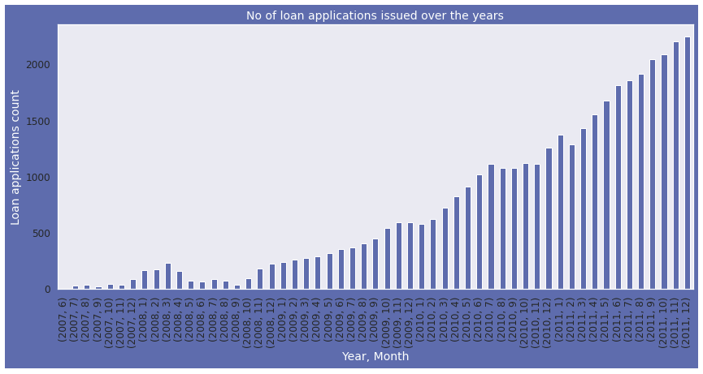
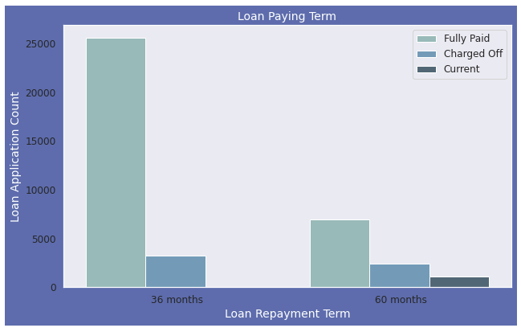
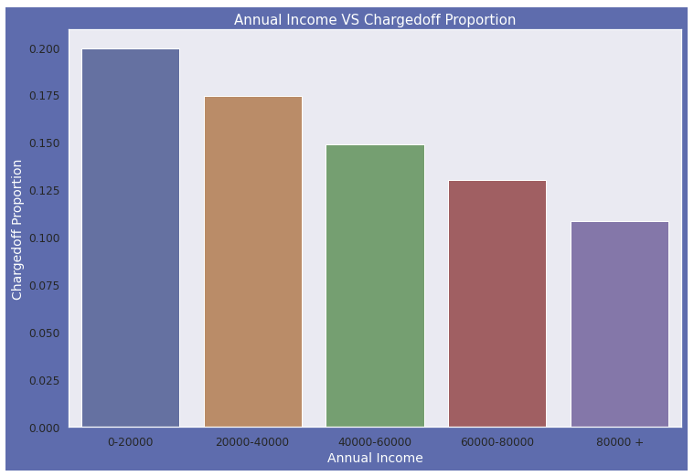
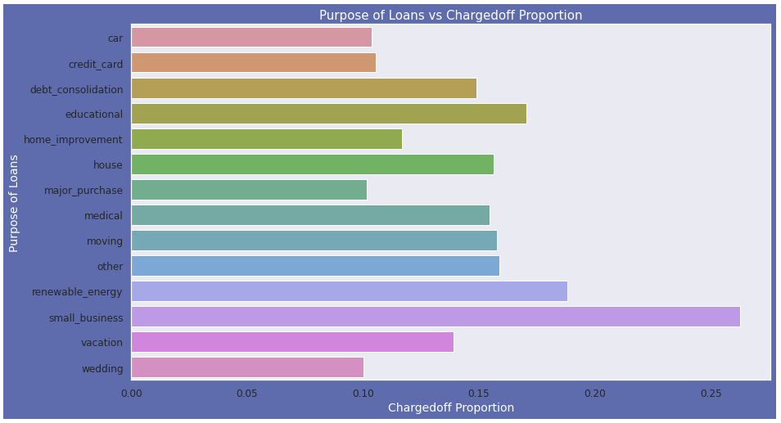
Univariate Analysis

Slide 12
We Observed that count of loan application is increasing every passing year.
So increase in number of loan applications are adding more to number of charged off applications.
Number of loans issued in 2008( May-October) got dipped, may be due to Recession.
Plot shows that those who had taken loan to repay in 60 months had more % of number of applicants getting
Charged off as compared to applicants who had taken loan for 36 months.
Income range 80000+ has less chances of charged off.
Income range 0-20000 has high chances of charged off.
Notice that with increase in annual income charged off proportion got decreased.
Small Business applicants have high chnaces of getting charged off.
Renewable_energy where chanrged off proportion is better as compare to other categories.

Slide 13
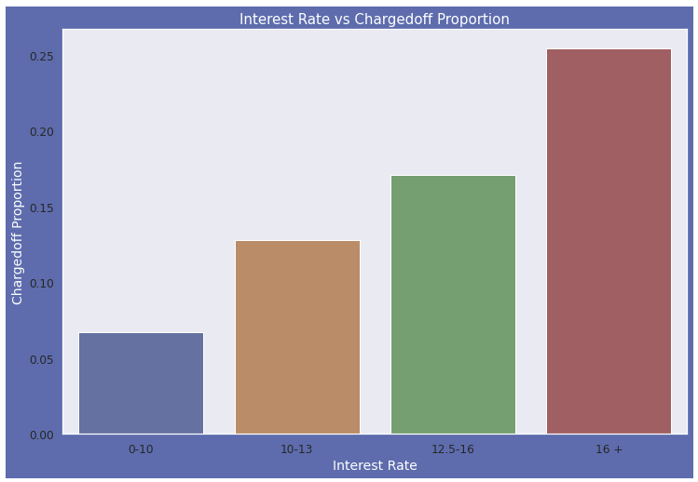
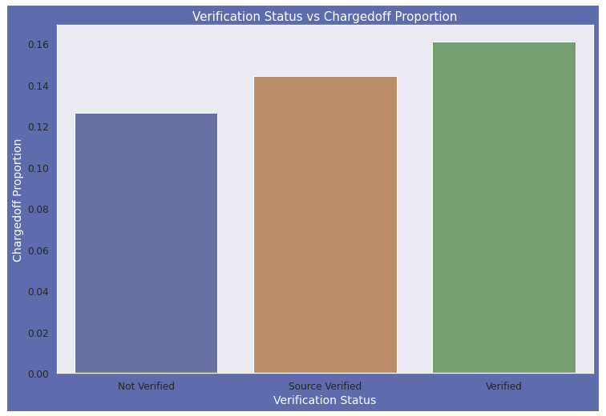
Bivariate Analysis

Slide 14
Observations:
Interest rate less than 10% has very less chances of charged off. Intrest rates are starting from minimin 5 %.
Interest rate more than 16% has good chnaces of charged off as compared to other category intrest rates.
Charged off proportion is increasing with higher intrest rates.
There is not much difference in charged off proportion.
This variable doesn't provide any insights for charged off.

Slide 15
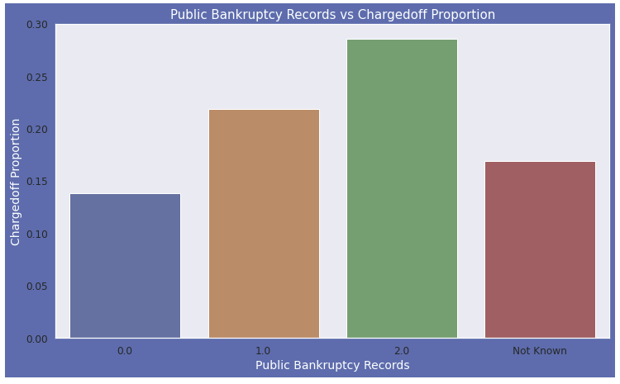
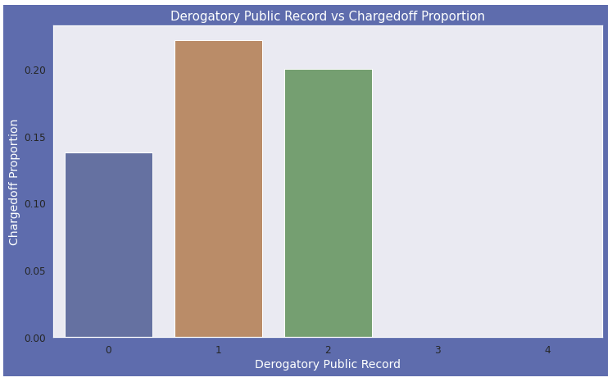
Observations:
A derogatory item is an entry that may be considered negative by lenders because it indicates risk and hurts your ability to qualify for credit or other services. Public records and collections are derogatory items because they reflect financial obligations that were not paid as agreed.
Those who already have pub_rec value 1 or 2 have charged off chances higher than who have no Derogatory Public Record. pub_rec count 3-4 has less numbers so cannot reach on any conclusions.

Slide 16
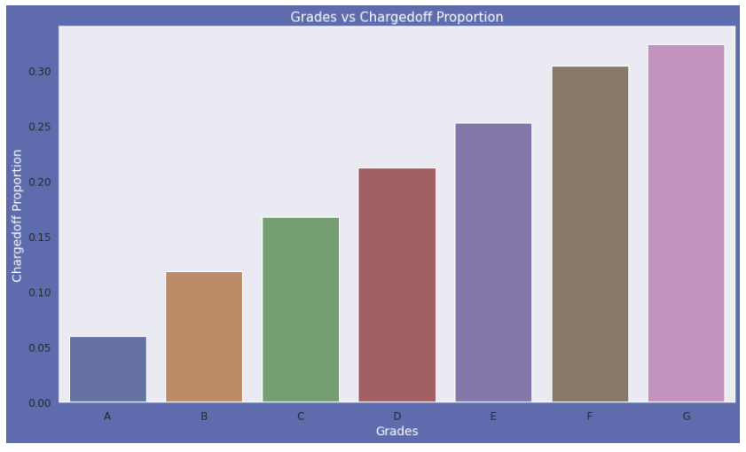
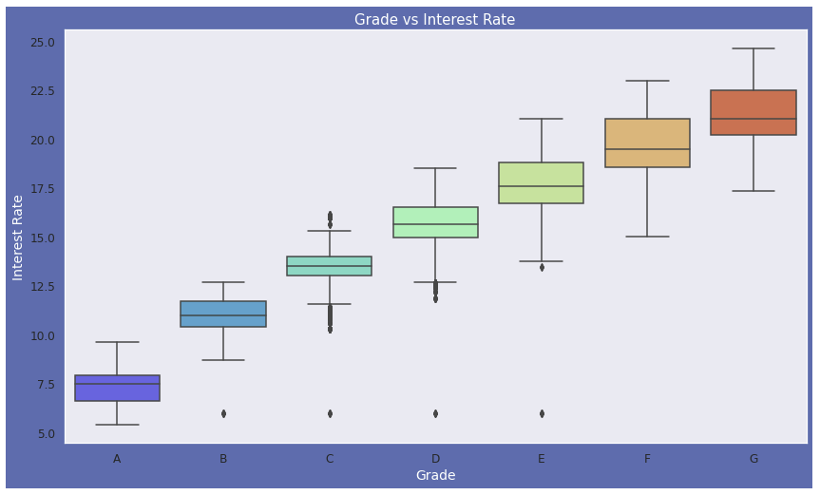
Grade Analysis
Observations:
Sub Grades of "A" has very less chances of charged off whereas "F" and "G" have very high chances of charged off.
A-grade is a top letter grade for a lender to assign to a borrower.
The higher the borrower's credit grade, the lower the interest rate offered to that borrower on a loan.
It is clear that intrest rate is increasing with grades moving from A to F.

Slide 17
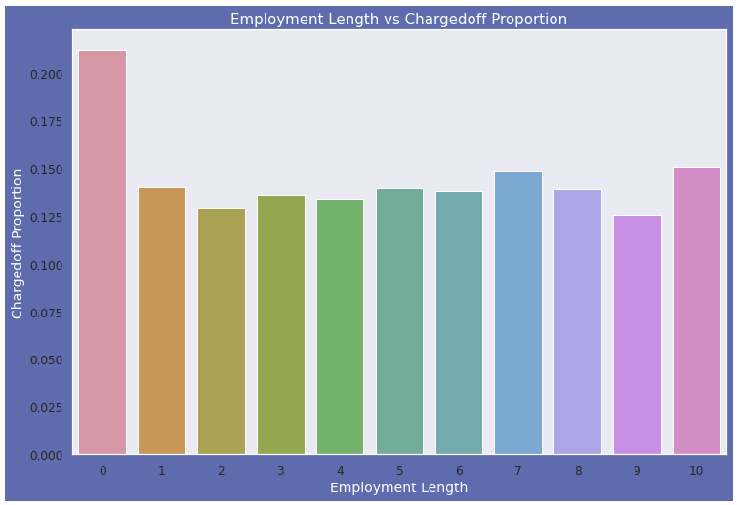
Employment Length VS Chargedoff Proportion
Observations:
Those who are not working or have less than 1 year of work experience have high chances of getting charged off.
It makes sense as with less or no experience they don't have source of income to repay loan.
Rest of the applicants have more or less same chances of getting charged off.

Slide 18
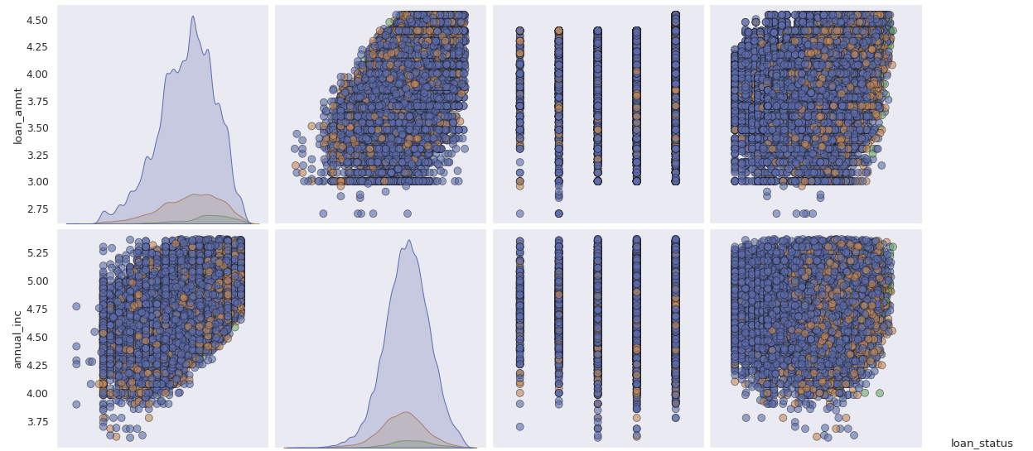
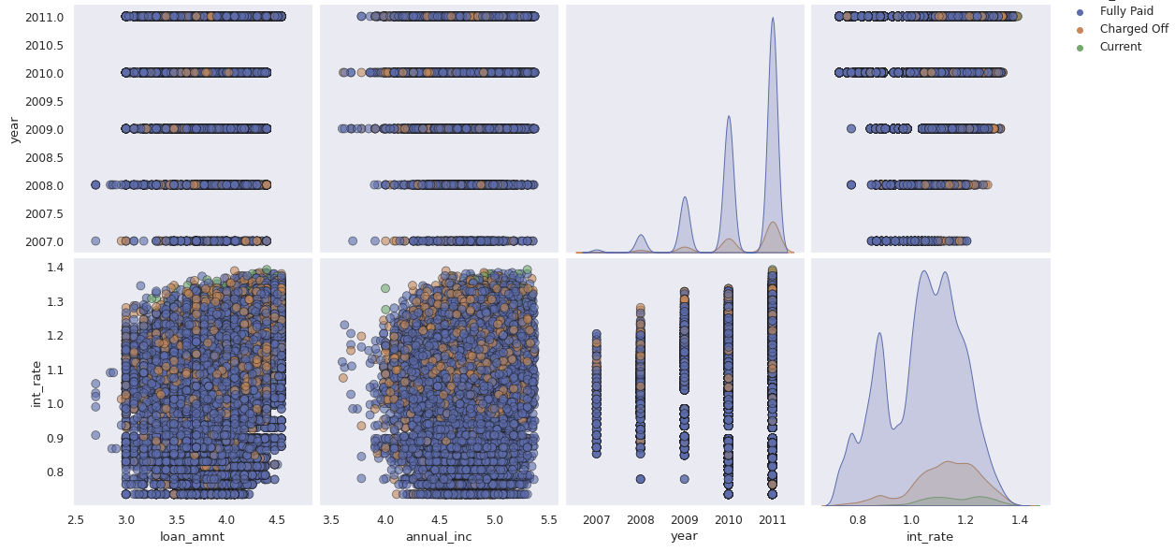
Multivariate Analysis

Slide 19
Observation:
Higher the interest rate higher charged off ratio.
Higher the annual income higher the loan amount slightly.
Increase in number of charged off with increase in year.
Interest rate is increasing with loan amount increase.

Slide 20
Suggestions
1. Annual income with DTI is negatively correlated.
This means higher the income, lesser the chances of getting charged off. So, eligibility criteria should be modified. The minimum salary required for the approval of loan should be increased.
2. Also it would be better to ask for bank statement of around 3 years.
Usually, for approving loans, balance sheet of 1 year is taken by lenders. This will not give insights of how stable the source of income is, and how much exponential growth the particular borrower gets each year in his/her job/career.
Eg. If a borrower had monthly income of 25k in first year and he had income of 30k in second and 35k in third year, it shows that the growth is less and he/she gets less increments. It can be predicted that in fourth year, he will likely have 40k .
Now consider somebody had monthly income of 5k in first year, 25k in second year, 35-40k in third year, it implies that he/she has high growth and increment is high. And it can be predicted that the the borrower will likely have salary of 50+k in fourth year.
So, it can be determined who is likely to get higher salary in future through this bank statement of around three years.
3. It is observed that higher the interest rate, higher is the chances of getting charged-off.
So its better to lower the rate of interest so that chances of getting charged off gets reduced to a little extent.

Slide 21
Thank You!!!

